Slide 1
TDD and Coding Kata

Slide 2

Agenda
What is TDD
What is a kata
Demo

Slide 3
TDD (Test driven development)
Writing unit tests before the production code is written

Slide 4


Slide 5
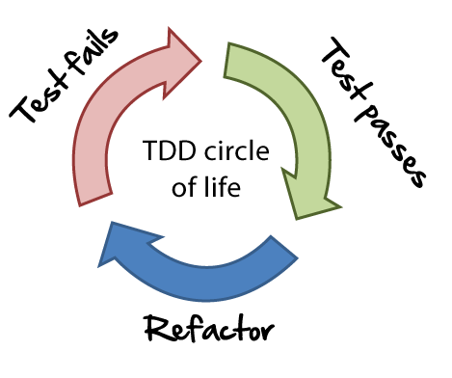
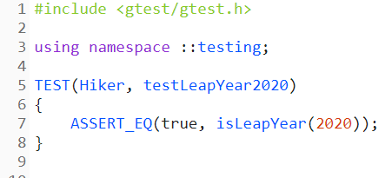
Step 1

Slide 6
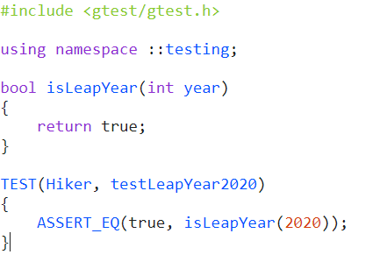
Step 2

Slide 7
Step 3

Slide 8
The technique of TDD

Slide 9
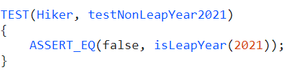
Example contd…

Slide 10
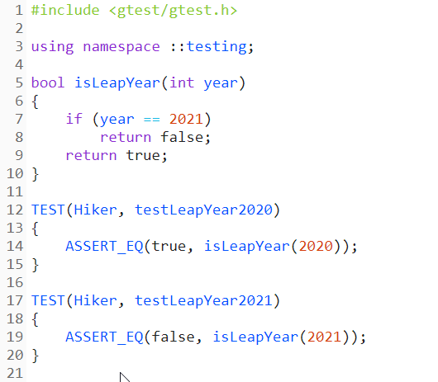
Example contd…

Slide 11
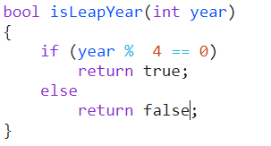
Example contd…

Slide 12

Advantages of TDD
Well tested code
Different point of view
Code written is testable
Acts as a form of documentation
…
Notes:
Every line of code, every method is tested.
- While new code is added, we would know if our code breaks some other functionality.
Writing test first, forces us to think from a different point of view.
- We will try to make methods/classes conveniently callable.
We make the code testable.
- Writing test first forces us to decouple the software.
Writing test first, acts as a form of documentation.
How to call a function or create a object can be directly viewed from tests.

Slide 13
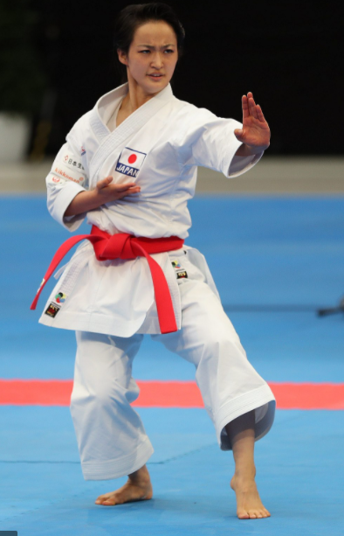
Kata
An individual training exercise in karate and
other martial arts.

Slide 14
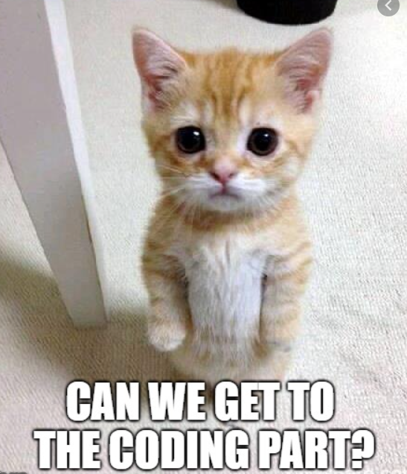
Notes:
https://cuckoo.team/
https://mobti.me/
https://cyber-dojo.org

Slide 15
Exercise
Let us use TDD to develop “FizzBuzz” kata Using C# and Nunit.
Notes:
https://cuckoo.team/
https://mobti.me/
https://cyber-dojo.org/kata/edit/D6HyKm

